Slide 1
Opportunities and uncertainties in the Critical Mineral Value Chain
Rishabh Jain
India International Centre, New Delhi
28 August 2023
© Council on Energy, Environment and Water, 2023

Slide 2
Impacting sustainable development at scale with data, integrated analysis, and strategic outreach
TRANSFORMATIONS
QUALITY OF LIFE
ENABLERS
250+
Multidisciplinary team
380+
Peer-reviewed publications
190+
Instances of increased data transparency
540+
Roundtables & conferences
20+
Indian states engaged
130+
Bilateral & multilateral initiatives promoted
Low-carbon Economy
Clean Air
Sustainable Finance
Energy Transitions
Sustainable Water
Technology Futures
Power Markets
Sustainable Food Systems
Circular Economy
Industrial Sustainability
Sustainable Cooling
Climate Resilience
Sustainable Livelihoods
Sustainable Mobility
International Cooperation
SPECIAL INITIATIVES
CEEW Centre for Energy Finance
Powering Livelihoods
Emerging Economies
UP State Office

Slide 3
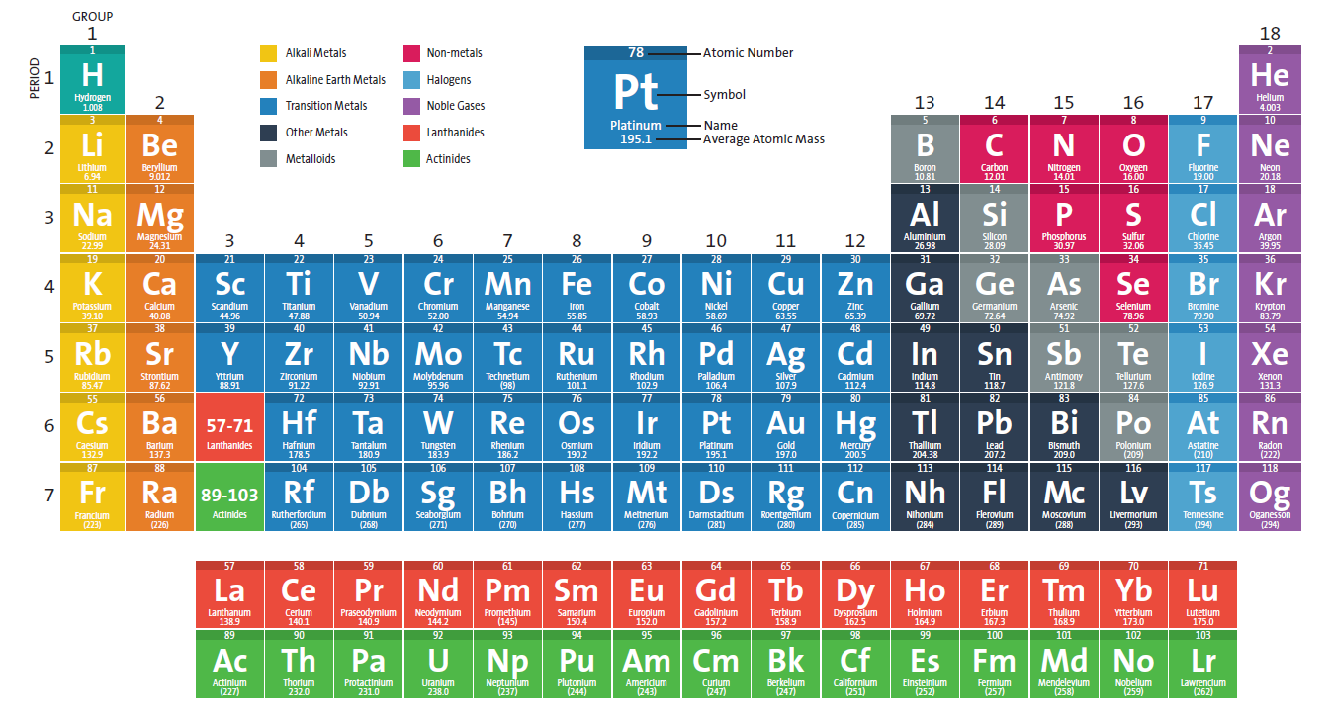
Minerals are formed from various elements and each of them have unique characteristics
Source: Ministry of Mines (2023) Image source: American Chemical Society

Slide 4
Minerals with high supply and vulnerability risks are often categorised as Critical Minerals
Non-Critical minerals
(Low-vulnerability, high supply risk)
Critical minerals
(High-vulnerability, high supply risk)
Supply risk
Non-Critical minerals
(Low-vulnerability, low supply risk)
Non-Critical minerals
(High-vulnerability, low supply risk)
Vulnerability/ economic importance
Source:

Slide 5
Multiple indicators can be used to calculate the mineral criticality index
Mineral criticality
Economic importance
National resource endowment
Geopolitical risk
Supply risks
Substitution risk
Recyclability risk
Industrial structure
Consumption pattern
Sectoral contribution to GDP
Sectoral mineral consumption
Import dependence
World governance index
Substitutability
Recycling potential
Source: CEEW

Slide 6
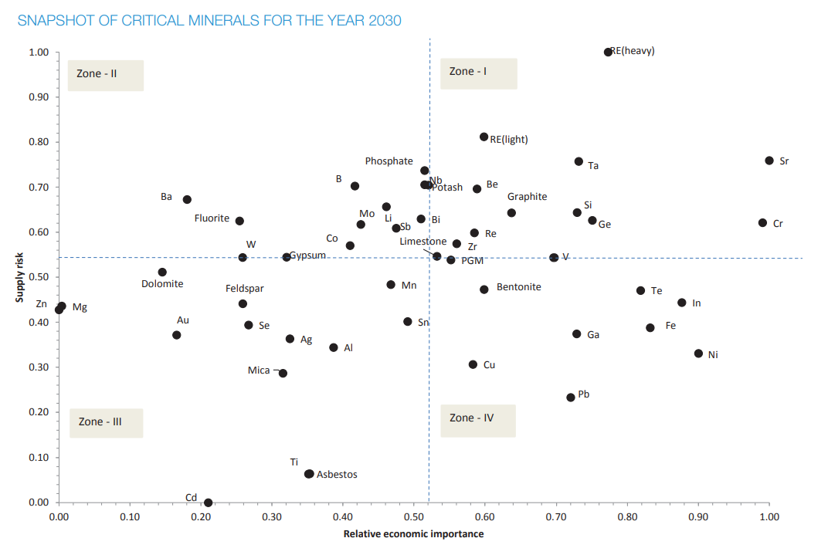
In 2016, CEEW had identified 49 minerals important for India
Source: CEEW analysis

Slide 7
In June 2023, MoM released the list of 30 minerals critical to India
S. No. | India’s critical mineral list
1 | Antimony
2 | Beryllium
3 | Bismuth
4 | Cadmium
5 | Cobalt
6 | Copper
7 | Gallium
8 | Germanium
9 | Graphite
10 | Hafnium
11 | Indium
12 | Lithium
13 | Molybdenum
14 | Niobium
15 | Nickel
16 | Platinum group elements (6)
17 | Phosphorous
18 | Potash
19 | Rare earth elements (17)
20 | Rhenium
21 | Selenium
22 | Silicon
23 | Strontium
24 | Tantalum
25 | Tellurium
26 | Tin
27 | Titanium
28 | Tungsten
29 | Vanadium
30 | Zircon
Source: Ministry of Mines (2023) Image source: American Chemical Society

Slide 8
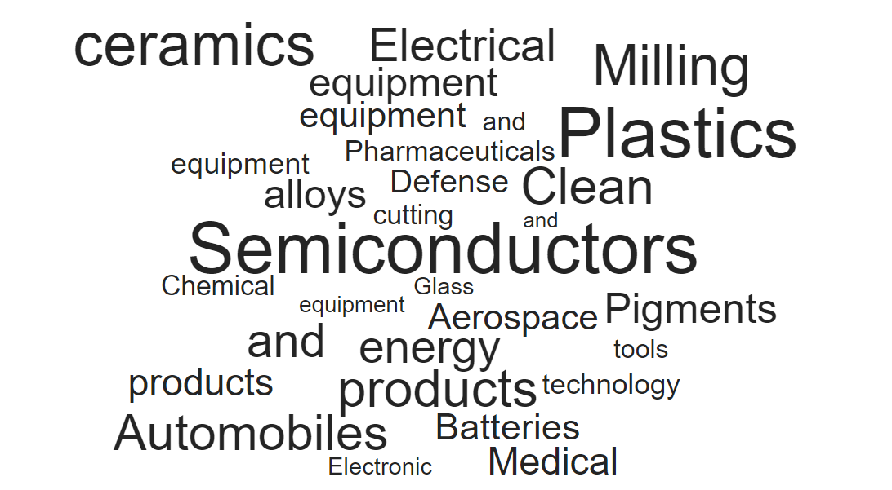
Critical minerals find use across sectors and the supply chain is distinct for each
Source: Ministry of Mines (2023)

Slide 9
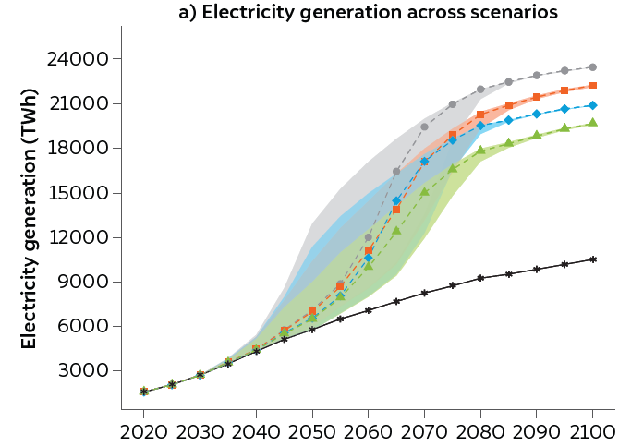
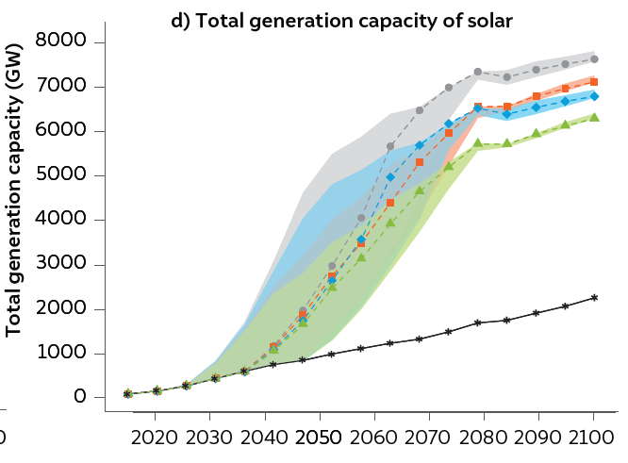
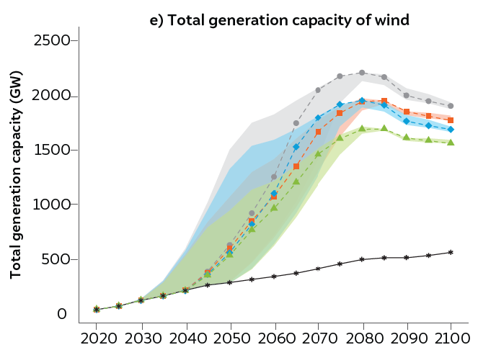
Multiple pathways can lead us to meeting our 2070 Net-Zero targets
Source: CEEW analysis

Slide 10
The market share of various technological variants can vary significantly in the future
Clean energy technology -> | Solar PV | Wind | Battery | Motors | Electrolyser
 | PERC (c-Si) | DD-EESG | High-nickel NMC | Permanent magnet | Alkaline
 | SHJ | DD-PMSG | Low-nickel NMC | Induction | PEM
Important technology variants -> | CIGS (thin film) | GB-PMSG | LFP |  | Solid-oxide
 | Silicon tandem cell | GB-DFIG | LMO-LTO
 |  |  | sodium-ion
 |  |  | vanadium flow
Note: PERC: Passivated emitter rear contact, SHJ: Silicon heterojunction, CIGS: copper indium gallium selenide; DD: direct drive, PM: permanent magnet, EE: electrically excited, SG: synchronous generator, GB: gearbox, DFIG: doubly fed induction generator; NMC: nickel manganese cobalt oxide, LFP: lithium ferro-phosphate, LMO: lithium manganese oxide, LTO: Lithium titanate oxide, PEM: proton exchange membrane

Slide 11
Each technology variant can have varied share of minerals and materials
 | Solar PV | Wind | EV (motor) | Battery (EV and stationary) | Electrolyser | Grid
 | Antimony | Bauxite (aluminium) | Boron | Bauxite (aluminium) | Nickel | Bauxite (aluminium)
 | Bauxite (aluminium) | Boron | Copper | Cobalt | Platinum | Copper
 | Copper | Chromium | Heavy rare earths | Copper |  | Iron (steel)
 | Gallium | Copper | Iron | Graphite
 | Indium | Heavy rare earths | Light rare earths | Iron
 | Nickel | Iron (steel) | Neodymium | Lithium
 | Selenium | Light rare earths |  | Manganese
 | Silicon | Manganese |  | Nickel
 | Silver | Molybdenum |  | Vanadium
 | Zinc | Neodymium |  | Zinc
 | Tin | Nickel |  | Phosphorus
 | Iron (steel) | Zinc |  | Fluorine

Slide 12
The market share of technological variant will determine the total mineral demand
 | Solar module material intensity (kg/MW)
Select technology variants -> | PERC | SHJ | CIGS | Tandem
Copper | 869 | 922 | 90 | 574
Silicon | 3038 | 2934 |  | 2362
Indium |  |  | 108 | 15
Gallium |  |  | 26 | 52
 | Wind turbine material intensity (kg/MW)
Select technology variants -> | DD-EESG | DD-PMSG | GB-PMSG | GB-DFIG
Copper | 5000 | 3000 | 950 | 1400
Rare earths | 44 | 239 | 62 | 14
Nickel | 340 | 240 | 440 | 430
Molybdenum | 109 | 109 | 119 | 99
Source: EU JRC (2020), Fraunhofer ISE (2022)

Slide 13
Upcoming and disruptive technologies can reduce the critical mineral demand
 | Battery material intensity (kg/MWh)
Select technology variants -> | Lithium ion (LFP-G) | Lithium ion (NMC532-G) | Lithium-ion (NMC811-G) | Vanadium flow | Sodium-ion*
Lithium | 96 | 126 | 93
Nickel |  | 522 | 614
Cobalt |  | 210 | 77
Phosphorus | 427 | 12 | 11
Copper | 466 | 311 | 284 | 220
Graphite | 1055 | 879 | 915 | 530
Vanadium |  |  |  | 5185
Source: EU JRC (2020), Fraunhofer ISE (2022)

Slide 14
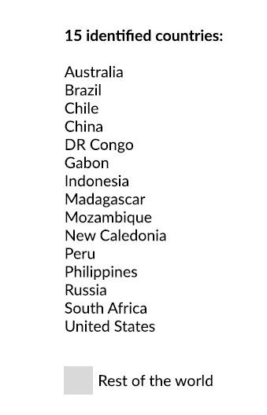
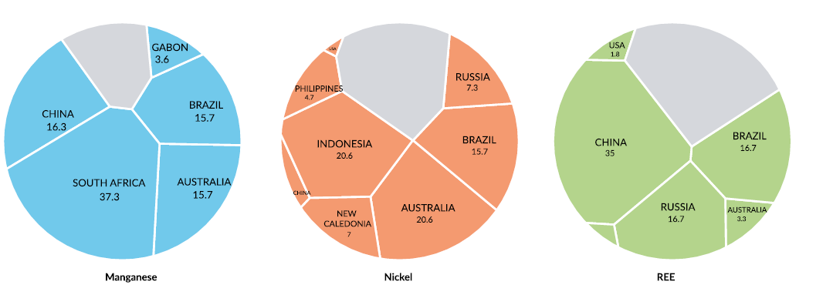
15 countries are home to at least 55 per cent of each of the identified critical minerals
Source: CEEW Analysis from USGS, 2023

Slide 15
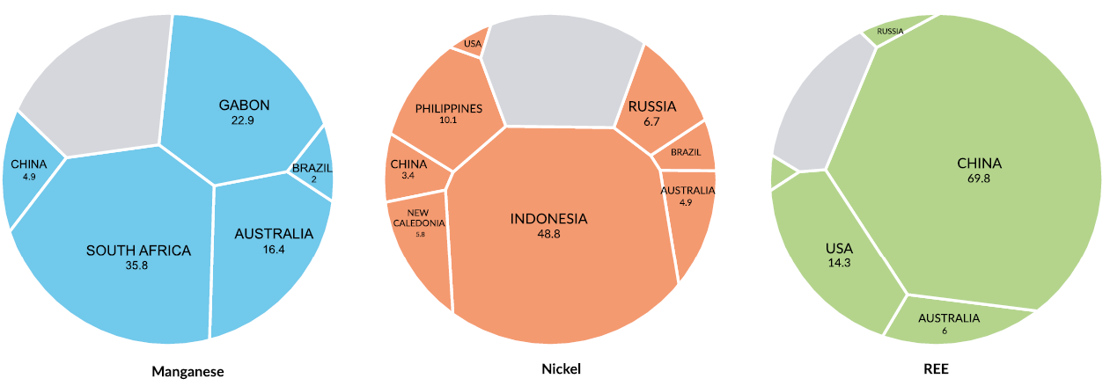
A handful of countries make up more than 70 per cent of the mine production of all of the identified critical minerals
Source: CEEW Analysis from USGS, 2023

Slide 16
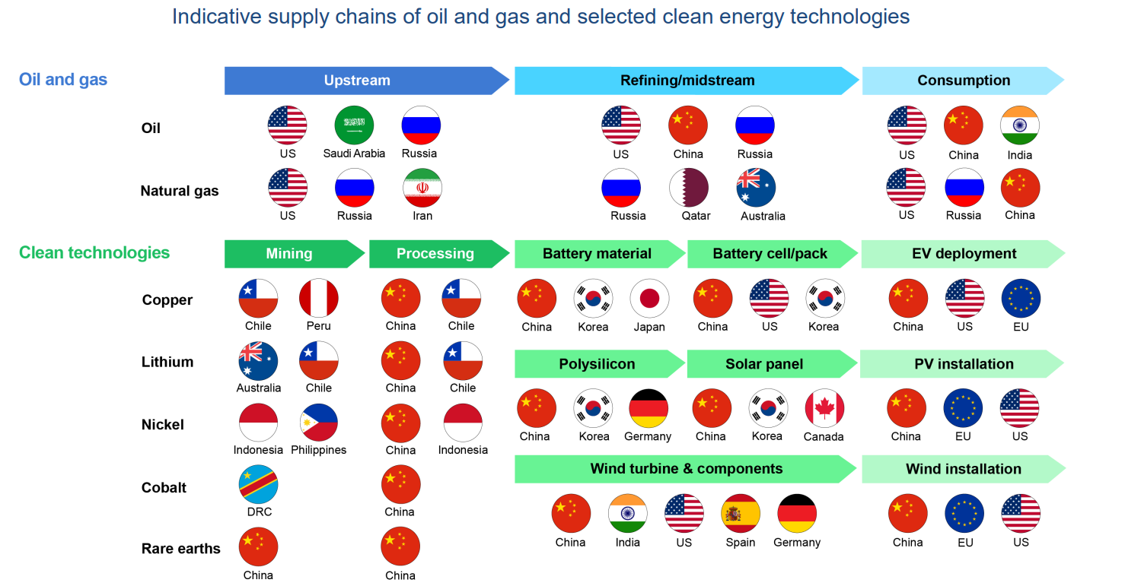
Upstream and midstream manufacturing processes are concentrated in few regions
Source: IEA (2021)

Slide 17
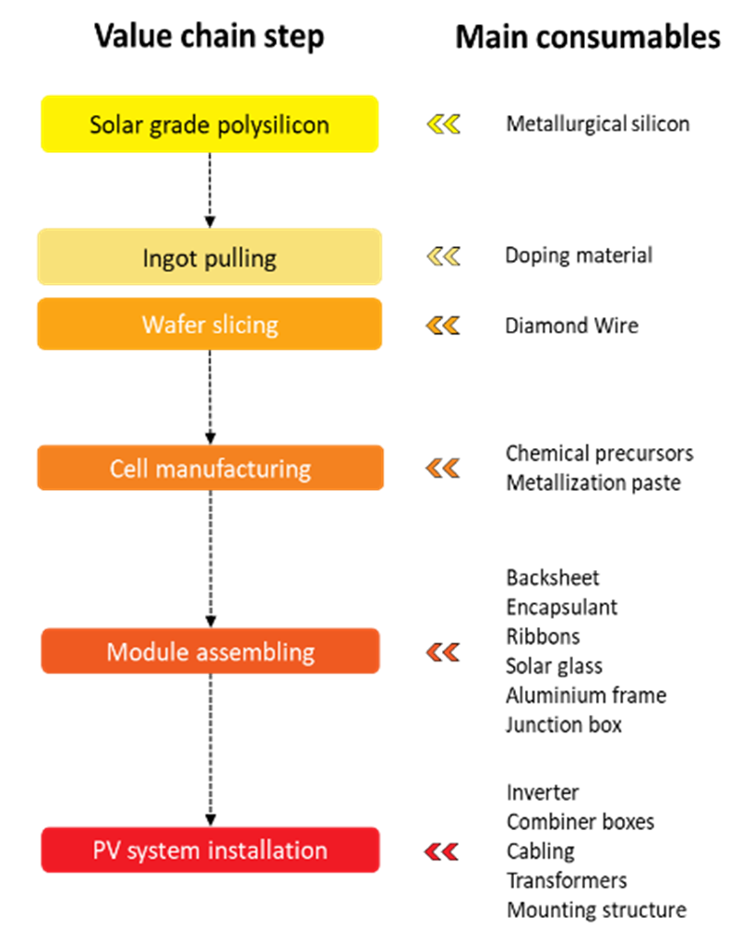
The upstream and midstream value chain will create new opportunities - Solar
17|
Source: ISA (2023)

Slide 18
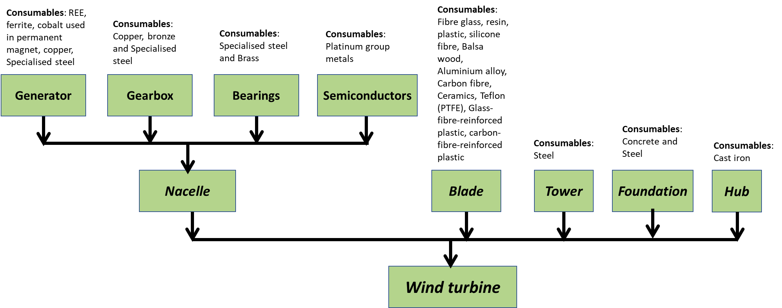
The upstream and midstream value chain will create new opportunities - Wind
18|

Slide 19
The upstream and midstream value chain will create new opportunities – LiB batteries
Consumable
Compounds of lithium, cobalt, nickel, manganese, iron and/or aluminium
Consumable
Graphite (synthetic/natural), silicon or LTO
Consumable
Polymer (polyolefin)
Consumable
LiPF6
Organic solvents
Cathode active material manufacturing
Anode active material manufacturing
Separator
manufacturing
Electrolyte manufacturing
Other consumable
Current collector foils (copper and aluminium), cell casing, binder, solvent
Cell manufacturing
Lithium-ion cell
Other consumable
Casing, connectors, battery management system hardware, communications bus
Battery assembly
Lithium-ion battery

Slide 20
How can India tap the upcoming opportunity
India will need to find more mineral resources to meet domestic and international demand. Exploration will be the key now.
For the existing mineral resources, timely and sustainable mining will be crucial so that import dependence can be reduced. New mining technologies need to be developed to increase mineral recovery but reduce impact on nearly ecology.
Indigenisation of mineral processing and raw material manufacturing will be important to increase the domestic value add of the mineral supply chain
India can leverage being the fastest growing economy and recover minerals from various products when they reach end of life
International collaboration & cooperation can speed up efforts and India should leverage the geopolitical sentiment of diversification

Slide 21
Thank you
ceew.in | @CEEWIndia

